Slide 1

BIG DATA TOOLS FOR MANAGERS
Unit-3 : Introduction to R
by
Ankit Velani
Adjunct Faculty, Dept. of MBA,
Siddaganga Institute of Technology,Tumkur

Slide 2
Session-1 Overview
Introduction to R-tool
R & R-Studio
Getting started with R
Variables
Comments
Working directory
Packages

Slide 3
Introduction to R
R is an open-source programming language and software environment for statistical & data analysis.
In 1993, R was created by Ross Ihaka and Robert Gentleman at the University of Auckland, New Zealand.
R name derived from the first letter of two founders (Ross & Robert)

Slide 4
How R is useful?
R has built-in features and functionality for statistical analysis and data visualization.
R can easily preprocess varieties of structure & unstructured data.
R is available for all the operating system (Windows, Linux, macOS), and easy to move R projects from one operating system to another operating system.
R supports Shiny App which is a web-based interactive app to develop and showcase R projects.
R has a wide & active community, and 10,000+ packages to improve project code and productivity while working with R.

Slide 5
R Tool Software
R Interpreter/software, which is available for all the OS
R documents and packages are available on Comprehensive R Archive Network(CRAN)
Official website :
http://www.r-project.org

Slide 6
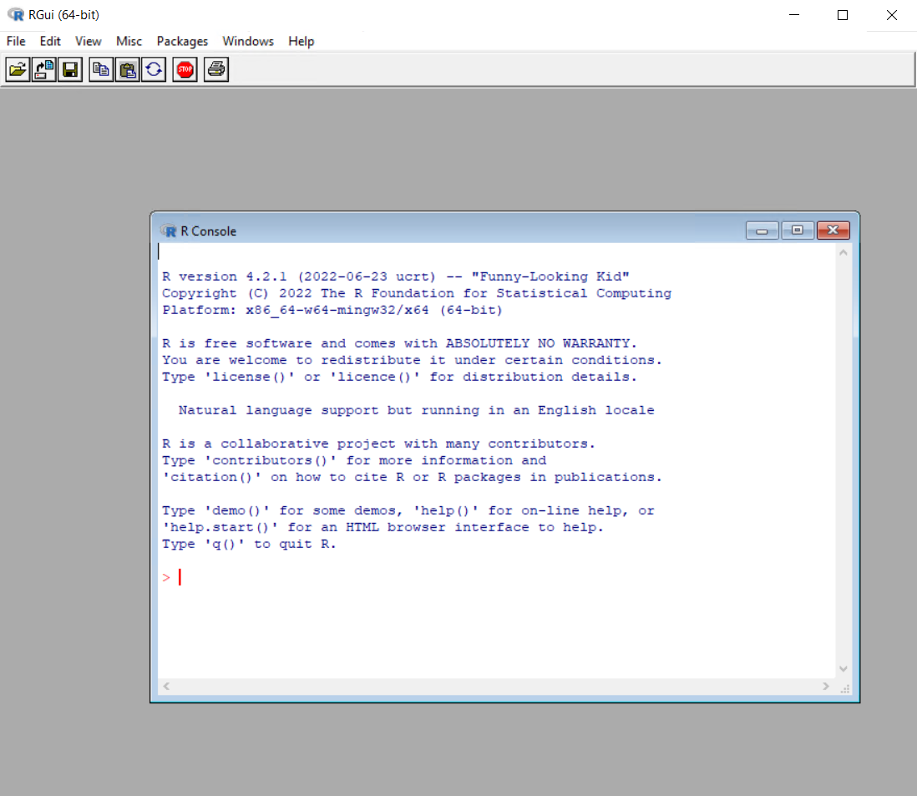
R Interpreter

Slide 7
RStudio
RStudio is development environments for R projects.
RStudio has a four main window panel
Code
Workspace
R Terminal
Output
Official website :
https://www.rstudio.com/products/rstudio/download/

Slide 8
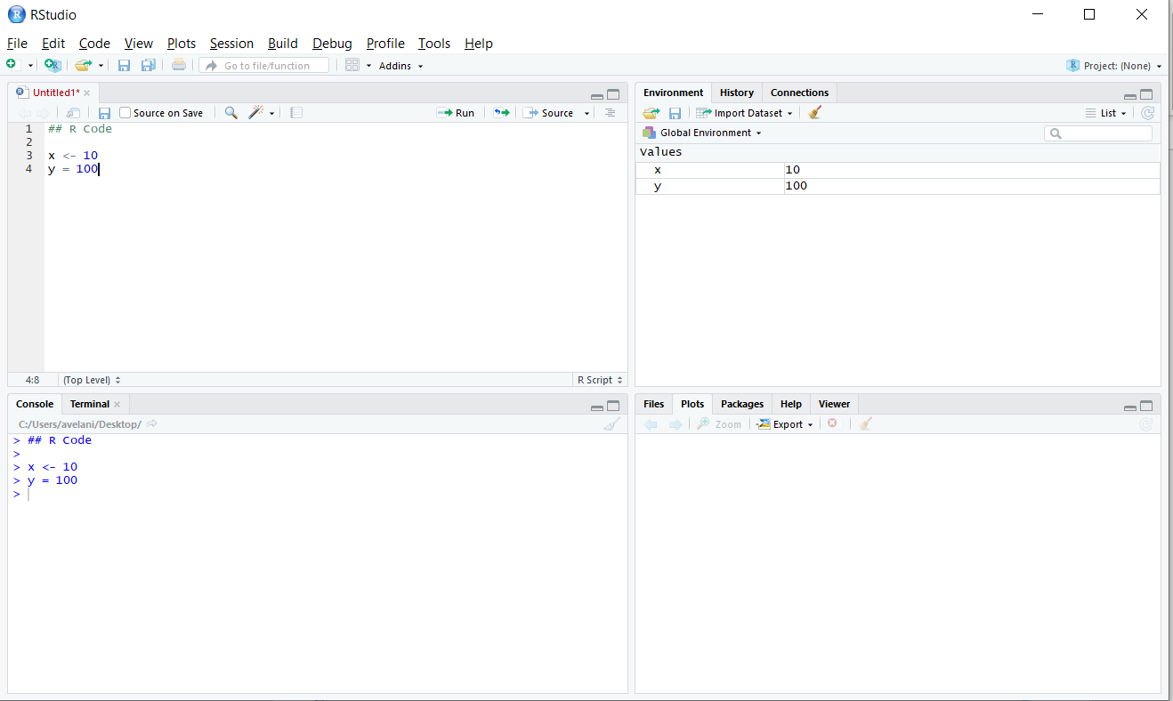
RStudio
R Codes/ Files
R Workspace
R Console / Terminal
Output, Packages & Help

Slide 9
Variables
Variables are container for storing data value in memory.
In R, Variable gets created as soon as it gets assign with some values to it.
R supports both ←(left assignment) and = (equal to) operator for assigning the value
Most prefer assignment operator is ←(left assignment)

Slide 10
Variables
Rules to create variable name:
Variable name must start with a letter and followed by letters, numbers, and underscore
Variable name cannot start with number or underscore
Variable names are case sensitive so ie. name, Name and NAME are three different variables
Reserved words can not be used as variable name(TRUE, FALSE, NULL, if…)

Slide 11
Variables
Example :
x ← 10
y = 100
a ← b ← c ← “hello”
R also allow to assign same value to multiple variable together.

Slide 12
Print
R does have print function to get the values of variable.
print(x)
print(y)
x ← 50 # Storing 50 value in memory and address is X
print(x)
() denotes
function call
Name
of function

Slide 13
Comments
R allows to annotate codes with Comments
Comments line starts with hash mark(#), and anything that comes thereafter will be ignored by R interpreter/tool.
Comments are highly recommended to keep notes, complex logic details and other details for documentation.
Ex.
# This is comment line
10 + 10 #addition of two number

Slide 14
Working directory
An Active R Session always has a working directory associated with it, unless you explicitly specify a file path when saving or importing data.
Working directory denotes by default R read/write data from working directory.
getwd() : get a current working directory name
getwd functions gives folder path displayed with forward slashes(/) to path to specific location
setwd(“path-to-folder”) : change current working directory
Needs to provide full path to specific folder with forward slashes(/)

Slide 15
Working directory
> getwd()
o/p:
"C:/Users/home/Documents“
> setwd(“D:/class/R/”)

Slide 16
R Packages
R tools comes with lots of built in commands, function for numeric calculations for common statistical analysis, plotting visualization.
R packages are collection of R functions code and sample data that stored under a directory which called “library” in the R environment.
R package easily available on CRAN network & over the internet.

Slide 17
R Packages
Install & download from Internet/ CRAN network
install.packages(“package-name”)
ie. > install.packages(“car”)
> install.packages(“caret”)
> install.packages(“MASS”)

Slide 18
R Packages
Install & download from Internet/ CRAN network
install.packages(“package-name”)
ie. > install.packages(“car”)
> install.packages(“caret”)
> install.packages(“MASS”)
Load/import package in R code
library(“package-name”)
Ie.
> library(“car”)
> library(“MASS”)

Slide 19
Recap
R is an open source programming language for statistical analysis.
To download R from official website (http://www.r-project.org)
R documentation & packages are available on CRAN (Comprehensive R Archive Network)
R Studio is development environment to develop & work with R projects.
R Studio has 4 window panel ( Code, Workspace, Terminal and Output)
Comments can be used to annotate R code and it start with hash(#)
getwd() functions to get the current working directory.
setwd() function to change or modify working directory.

Slide 20
Session-2 : R data types
Basic data types
Advanced data structures
Vectors
Lists
Matrices
Data Frames
Categorical data
Factors
Discretizing

Slide 21
Basic Data types
There are several basic data types in R and those frequent occurrences in the routine of R calculation.
While writing R programming, need to store the data in a variable and this data might be of different types like Integer, Decimal, String, Complex…etc
Data types are helpful to the programmer for understanding the types of data that developer is handling and manipulating.

Slide 22
Basic Data types
Data types | Values
Logical | TRUE or FALSE
Integer | Set of all the integer numbers
Numeric | Set of all the real numbers
Complex | Set of complex numbers ( a+bi)
Characters | The sequence of characters enclosed within single or double quotes

Slide 23
Code : R data types
Logical
> x ← TRUE
> print(x) #print function helps to display the value of x variable
> class(x) #class function helps to get the name/class of data type
Numeric
By default, all the numbers are numeric types and if we create numbers with the suffix L then it becomes an integer type of data.
> x ← 70.15
> print(x)
> class(x)

Slide 24
Code : R data types
Integer
> x ← 101L
> print(x)
> class(x)
Complex
> x ←6 + 4i
> print(x)
> class(x)
Characters
> x ← “Hello world to R programming”
> y ← ‘Y’
> print(x)
> print(y)
> class(x)
> class(y)

Slide 25
Vector
Vector is the essential building block for handling multiple items in R.
It’s a list of items that are of the same type.
Combine function c() used to combine multiple values of same time.
ie.
> fruits ← c(“Apple”, “Banana”, “Orange”)
> num ← c(1,2,3,4,5,6)
> num ← 1:100 #Integer values in a sequence
> dec ← 1.5 : 6.5 #Numeric values in a sequence

Slide 26
Vector
Length function which helps to find out how many items a vector has.
length(fruits)
length(num)
Combining two vectors
num_all <- c(num, dec)

Slide 27
Vector
Sequence
common useful functions to create continuous number generation.
seq(from=, to=, by=)
seq(from=, to=, length.out=)
Example:
seq(from=1, to=10, by=2)
seq(from=1, to=10, length.out=20)

Slide 28
Vector
Repeat
common useful functions to repeat the certain values in vector.
rep(x=1, times=4)
rep(x=c(1,2,3), each=2)
rep(x=c(1,2), each=2, times=4)
1122 1122 1122 1122
times → provide no of times entire vector elements to repeat
each →provide no of times each vector elements to gets repeat.

Slide 29
Vector
Sort
Sort function used to sort vector elements in increasing or decreasing order.
sort(x=, decreasing=)
x = is vector
decreasing is TRUE/FALSE
Example:
sort(x=c(2.5, -1, -10, 3.44), decreasing=FALSE)
#sort element in increasing order
Sort(x=c(2.5, -1, -10, 3.44), decreasing=TRUE)
#sort element in decreasing order

Slide 30
Matrices
A matrix is a two dimensional data set with columns and rows.
A column is a vertical representation of data, while a row is a horizontal representation of data.
A matrix can be created with the matrix () function. Specify the nrow and ncol parameters to get the amount of rows and columns:
m ← matrix(c(1,2,3,4,5,6), nrow=3, ncol=2)
print(m)

Slide 31
Matrices
m ← matrix(c(1,2,3,4,5,6), nrow=3, ncol=2)
print(m)
fruits <- matrix(
c(“apple”, “banana”, “cherry”, “orange”), nrow=2,
ncol=2
)
print(fruits)

Slide 32
Matrices
Filling direction:
R also allow to specify the filling direction for Matrix either by row or columns
byrow = TRUE/FALSE argument can control filling direction in matrix function.
m ← matrix(data=c(1,2,3,4,5,6),
nrow=3,
nrow=2, byrow=FALSE)

Slide 33
Matrices
m ← matrix(data=c(1,2,3,4,5,6),
nrow=3,
nrow=2, byrow=FALSE)
o/p:
1 4
2 5
3 6
m ← matrix(data=c(1,2,3,4,5,6),
nrow=3,
nrow=2, byrow=TRUE)
o/p:
1 2
3 4
5 6

Slide 34
Matrices
If we have multiple vectors of equal length then we can also create matrix using rbind(row bind) or cbind(column bind)
Ex
a ← c(1,2,3)
b ← c(4,5,6)
rbind(a,b)
1 2 3
4 5 6
cbind(a,b)
1 4
2 5
3 6

Slide 35
Matrices
dim() function is used to find the dimension of matrices.
> dim(m)
Output : number of rows, number of cols

Slide 36
Matrices
Accessing Elements
matrix_object[row-range, col-range]
Ex.
m[1:2] <- get the 1st element from row 1 & 2
m[1,1] <- get the 1st column from 1st row
m[1, 2] <- get the 2nd column from 1st row
m[3, 1:2] <- get the 1&2 columns from 3rd row
diag(m) <- get the diagonal elements of matrix

Slide 37
Operation on Matrices
A
2 5 2
6 1 4
Transpose t() function to get the transpose of matrix
-> t(A)
2 6
5 1
2 4

Slide 38
Operation on Matrices
A
2 5 2
6 1 4
Scaler multiplication of matrix
matrix_obj * scaler value
Ex:
A * 2
Output:
4 10 4
12 2 8

Slide 39
Operation on Matrices
A
2 5 2
6 1 4
B
2 3 2
3 1 2
Element wise arithmetic operation
matrix_object1 + matrix_objct2
matrix_object1 - matrix_objct2
matrix_object1 * matrix_objct2
matrix_object1 / matrix_objct2

Slide 40
Operation on Matrices
A
2 5 2
6 1 4
C
5 -3
-1 1
1 5
Matrix Multiplication
matrix_obj %*% matrix_obj
Example:
A %*% C

Slide 41
Data Frames
A data frame is R’s most natural way of presenting two-dimensional dataset with collection of observation with one or more variables.
Data frame is one of the most important and frequently used in R for data analysis.
data.frame() function helps to create data frame in R

Slide 42
Data Frames
Creation of data frame
my_data <- data.frame(
name = c(“A”,”B”,”C”,”D”),
age = c(40,45,70,60),
gender = c(“F”,”M”,”F”,”M”)
)
name, age, gender are the vectors
Output:
Name | Age | gender
A | 40 | F
B | 45 | M
C | 70 | F
D | 60 | M

Slide 43
Data Frames
Accessing elements
data-frame_object[ row_range , col_range ]
my_data[1, ] #first row with all the columns
my_data[1,3] # first row with only 3rd columns
my_data[1, 2:3 ] # first row with 2 & 3rd columns
my_data[2:3, 1] # 2 & 3rd row with 1st columns

Slide 44
Data Frames
Accessing elements with Variable Name
data-frame_object$variable_name
my_data$name
my_date$age
Accessing elements with condition on row index
data-frame_object[condition, ]
my_data[my_data$gender==“M”, ]
my_data[my_data$gender==“F”, 2]

Slide 45
Lists
List is powerful data structures in R, which allows to group together any kind of data types & data.
A single list contains vectors, matrix, logical vector, character, Data frame and list it self
list() function used to create a list in R
my_list <- list(c(1,2,3,4,5,6),
“John”
my_data)

Slide 46
Lists
Accessing List element: list element can be accessible by double square brackets with index.
my_list <- list(c(1,2,3,4,5,6),
“John”
my_data)
my_list[[1]] <- first elements from list
my_list[[2]] <- second elements form the list

Slide 47
Categorical data - Factors
Factors in R Programming are data structures that are implemented to categorize the data or represent categorical data and store it on multiple levels.
Factors may look similar to character vectors, but factor has levels and represent categorized data in a numeric format in memory to process categorical data efficiently.
The Factors accepts only restricted number of unique values.
Example:
A data field/vector such as gender may contains predefine set of values like Male, Female, Transgender.
This distinct/unique values are also knowing as levels.

Slide 48
Categorical data - Factors
Creating Factors:
factor() function use to create factors on categorical data.
Two steps:
- Create Vector
- Convert Vectors into Factors using factor() function
Example:
gender ← c(“Male”, “Female”, “Male”, “Male”)
gender_f ← factor(gender)

Slide 49
Categorical data - Factors
User can also define predefined levels in Factor with levels parameters in factor function.
Example:
x ← c(“medium”, “high”,”medium”, “low”,”high” ,”low”)
x_f ← factor( x , levels = c(“low”,”medium”, “high”)
levels() function to get the levels of the factor object.
Example:
levels(x_f)

Slide 50
Categorical data - Factors
Accessing Elements
Accessing elements of factor is same way of accessing any vectors.
factor_obj [index-range]
gender_f[1]
gender_f[2:4]
gender_f[2]

Slide 51
Categorical data - Factors
Modification of Factors
After a factor formed, its components/level can be modified but the new values to be assigned and must be added in predefined level first.
gender ← c(“Male”, “Female”, “Male”, “Male”)
gender_f ← factor(gender)
gender_f[3]
# add the level first
levels(gender_f) ← c(“Male”, “Female”,”Transgender”)
gender_f[3] ← “Transgender”
print(gender_f)

